Slide 1
IN THE NAME OF ALLAH
تو چون از باد بگذشتی، مقیم چشمه یی گشتی حریف همدمی گشتی که آبی بر جگر دارد(مولانا)

Slide 2

An introduction to Python
Learn to code USING python
Lecturer: Fardin Ibrahimi
Tolo-e-Aftab University, NOV 2022

Slide 3
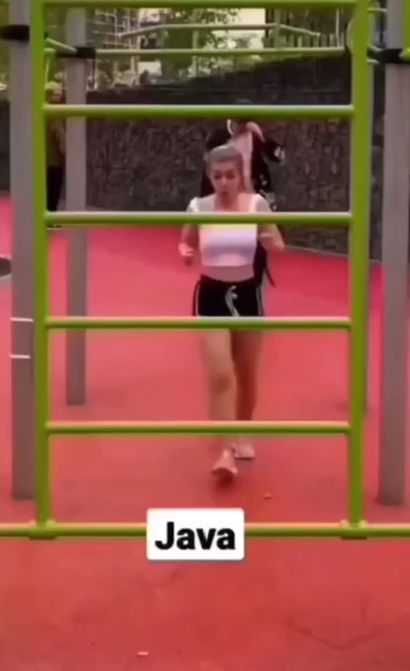
Python vs java vs c++

Slide 4
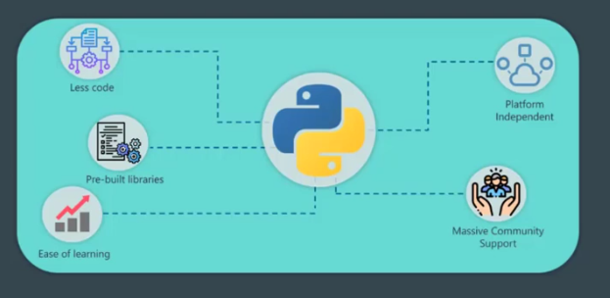
Why Python?!

Slide 5
Python Installation
Download and install Python
Python --version
Py or python
Hello World Program!

Slide 6
Different Types of variables
String
First_name = “Fardin”
Numbers
Age = 22
Boolean
Is_male = True

Slide 7
Variable types quiz
What kind of variable (Male = True) is?
Bool
Number
String
Float

Slide 8
Strings
print (“Fardin\nIbrahimi”)
print (“Fardin\t Ibrahimi”)
First_Name = “fardin”
Lastname = “ibrahimi”
Full_Name =First_Name + Lastname
Full_Name.lower()
Full_Name.upper()

Slide 9
Strings
Full_Name.replace(“i”, “e”)
print (len(Full_Name))
print (Full_Name.index(“F”))
print (Full_Name.index(“Ibrahimi”))
print (Full_Name[5])

Slide 10
Strings (QUIZ Part)
Display “Ahmad” in line 1 and “Karimi” in line 2.
Change “FARDIN” to lower case!
Change “fardin” to upper case!

Slide 11
Numbers
Example
N1 = 10
N2 = 20.1
Result = N1 + N2
print (“The result is :” + str(Result))

Slide 12
User input
Example
Name = input (“Please input your name: ”)
print (“Your name is: ” + Name)

Slide 13
IF statements
Example:
N1 = input (“please input number 1:”)
N2 = input (“please input number 2:”)
Operation = input (“please input + or –”)
if Operation == “+”
Result = float(N1) + float(N2)
elif:
Result = float(N1) – float(N2)
else:
print (“The operation is not valid! Choose + or - ”)
print (Result)

Slide 14
Note!!! Global Variables
Example:
def one ():
global x
x = 34
print (x)
one()
print (x)
What will be the result of the following code?
print (w)
def two ():
global w
w = 1000
print (w)
two()
print (w)

Slide 15
Note!!! Global Variables
Example (What will be the result?):
def two ():
global w
w = 34
print (w)
two()
print (w)
def three ():
print (w)
three()

Slide 16
Operators
>, <, >=, <=, ==, !=, +=, -=, *=, /=, %
Quiz and Example:
if the age of the users are not equal or greater than 18 they can not login to your website.
Logical operators:
and, or
not:
if not (age >= 18):
print(“Sorry, you are not allowed to login!”)

Slide 17
Lists
One of the most useful data structures in Python.
It is index-based.
Colors = [“Green”, “Red”, “White”, “Blue”]
print (Colors[3])
print (Colors[-1])
print (Colors[1:3]
print (Colors[:3]
print (Colors[1:]
print (Colors[1:-1]

Slide 18
Lists
Colors[1] = “Yellow”
Colors[2:3] = [“Sky blue”, “Purple”]
print (len (Colors))
Colors.extend([“Dark green”, “Dar Gray”, “Pink”])
Colors.append(“Dark Red”)
Colors.insert(1, “Dark Orange”)
Colors.remove(“Pink”)
Colors.clear()

Slide 19
LISTS
print (Colors.index(“Dark Gray”))
print (Colors.count(“Dark Gray”))
Colors.sort() -> It changes the main list.
Colors_sorted = sorted(Colors)-> doesn’t change the main list.
Colors.reverse() -> Reverses the list
Colors.pop() -> Removes the last index
Colors.pop(2) -> Removes the 2nd index
del Colors

Slide 20
List (quiz)
List1 = [22,33,44,55,66,77,88,99,100]
What is 5th element?
Change the 7th element to 700
Remove the 4th element

Slide 21
Tuples
Immutable data structure
Shopping_tuple = (“Tomato”, “Potato”, “Bread”)
print (Shopping_tuple[1])
print (len(Shopping_tuple))
Shopping_tuple[1] = “Kabab” -> Error

Slide 22
Functions
Example 1:
def say_hello():
print (“Hello!”)
say_hello()
Example 2:
def say_hello(name, age):
print (“Hello ” + name + “ Your age is: ” + str(age))
First_name = “Fardin”
Person_age = 20
say_hello(Firstname, Person_age)

Slide 23
Functions
Example 3:
def add_numbers (number1, number2):
Addition = number1 + number2
return Addition
Num1 = 10
Num2 = 30
Result = add_numbers(Num1, Num2)
print (Result)

Slide 24
LOOPS (while)
Example:
i = 1
while i < 6:
print (i)
i += 1
print (“done”)

Slide 25
Loops (for)
Example 1:
Shopping_list = [“Potato”, “Tomato”, “Bread”]
for item in Shopping_list:
print (item)
Example 2 (Homework, 5 mins):
Text = “Fardin Ibrahimi”
Count = 0
for item in Text:
if item == “a”:
Count += 1
print (Count)

Slide 26
Loops (for)
Example 3:
for i in range(5):
print (i)
Example 4:
for i in range(1,6):
print (i)
Example 5:
for i in range(1, 10, 2):
print (i)

Slide 27
LOOPS (QUIz)
Iterate on the list [“Ahmad”, “Mahmood”, “Jameela”, “Tor Paykai”]

Slide 28
Dictionaries
Key: Value
Example:
Week_days = {
“sat”: “Saturday”,
“sun”: “Sunday”,
“mon”: “Monday”
}
print (Week_days[“sat”])
print (Week_days.get(“sat”))
print (Week_days.get(“Boy”, “Not a valid key!”))

Slide 29
Dictionaries quiz
Build a dictionary for students with the following keys:
Name
Age
Gender
Contact
Date of birth

Slide 30
Multi Dimensional lists
Example:
Cubes_list = [
[2, 3, 5],
[2, 8, 6],
[3, 2, 5],
]
print (Cubes_list[1][1])

Slide 31
Classes
SoccerPlayer.py:
class Player:
def __init__(self, name, age, team, injured):
self.name = name
self.age = age
self.team = team
self.injured = injured
def get_status(self):
print (self.name + str(self.age) + “---” + “Injured: ” + str(self.injured))
App.py:
from SoccerPlayer import Player
Player1 = Player (“Messi”, 35, “PSG”, True)
Player1.name
Player1.injured = False
Player1.get_status()

Slide 32
Inheritance
People.py
class Student:
def __init__(self, fname, lname, age):
self.fname = fname
self.lname = lname
self.age = age
def display_info (self):
print (“Student- my full name is: " + self.fname + " " + self.lname + ". age: " + str(self.age)) class Teacher:
def __init__(self, fname, lname, age):
self.fname = fname
self.lname = lname
self.age = age
def display_info (self):
print (“Teacher- my full name is: " + self.fname + " " + self.name + “. age: " + str(self.age))

Slide 33
Inheritance
App.py
from People import Student
from People import Teacher
Student1 = Student(“Fardin”, “Ibrahimi”, 22)
Teacher1 = Teacher(“Zekrullah”, “Popal”, 67)
Student1.display_info()
Teacher1.display_info()

Slide 34
Inheritance (people.py, Less code)
class Human:
def __init__(self, fname, lname, age):
self.fname = fname
self.lname = lname
self.age = age
def display_info (self):
print ("My full name is: " + self.fname + " " + self.lname + ". My age is: " + str(self.age))
class Student (Human):
def display_info (self):
print ("Student:my full name is: " + self.fname + " " + self.lname + ". My age is: " + str(self.age))
class Teacher(Human):
def display_info (self):
print ("Teacher:my full name is: " + self.fname + " " + self.lname + " My age is: " + str(self.age))

Slide 35
Inheritance (App.py)
from People import Student
from People import Teacher
Student1 = Student(“Fardin”, “Ibrahimi”, 22)
Teacher1 = Teacher(“Zekrullah”, “Popal”, 67)
Student1.display_info()
Teacher1.display_info()

Slide 36
Reading FILES
films = open ("films.txt", "r") print (films.readline())
films1 = films.readlines()
for item in films1:
print (item)
films.close()

Slide 37
Appending on files
films = open ("films.txt", "a")
films.write("\nComprehensive movies file!")
films.close()

Slide 38
Writing to files
films = open ("films.txt", "w")
films.write("I am fardin!\nAnd my lastname is ibrahimi!")
films.close()

Slide 39
*args
Example:
def hello():
print (“Hello how are you?”)
hello(“fardin”) -> The function will give you error because it takes no argument.
Solution:
def hello(*args):
print (“Hello how are you?, args)
hello(“fardin”) -> No error!

Slide 40
**kwargs
Example:
def hello ():
print (“Hello how are you?)
hello (name = “fardin”) -> The function returns error because it takes no keyword argument!
Solution:
def hello (**kwargs):
print (“Hello how are you?)
Hello (name = “fardin”) -> No error!

Slide 41
__init__
Example:
Student_info.py
class student:
def __init__ (self, name, lname, age):
self.name = name
self.lname = lname
self.age = age
App.py:
from Student_info import student
Student1 = student(“Fardin”, “Ibrahimi”, 22)
print (Student1.name)

Slide 42
super()
Used to give access to the methods of a parent class
Example:
class school_members:
def __init__ (self, name, lastname, age):
self.name = name
self.lastname = lastname
self.age = age
class student (school_members):
def __init__(self, name, lastname, age):
super().__init__(name, lastname, age)
class teacher (school_members):
def __init__ (self, name, lastname, age):
super().__init__(name, lastname, age)

Slide 43
enumerate()
Returns a sequence of (index, item) tuples
Example:
fruits = ['apple', 'orange', 'pine apple']
list(enumerate(fruits))
for index, fruit in enumerate (fruits):
print (index, fruit)
The result will be:
0 apple
1 orange
2 pine apple

Slide 44
Lambda
Example:
def square (num):
return num ** 2
But lambda:
x = lambda num : num ** 2
print (x (2))
More arguments:
x = lambda num1, num2 : num1 ** num2
print (x (2, 4))

Slide 45
The end
? ! ☹

